Slide 1
Geoportfolio presentation
Professional Practice (GEOM2116)
Nicholas Lee

Slide 2


What you need
A working computer
Visual Studio Code: https://code.visualstudio.com/Download
GitHub: https://github.com/
Any images you want on your Geoportfolio saved in the same folder as your HTML and CSS files.

Slide 3

Getting started
Unzip the “Geoportfolio template” zipfile from Canvas.
Right-click the index.html file, go to “Open with” and choose “Visual Studio Code”.
Alternatively, open Visual Studio Code and go to File→Open file→Click on index.html from the Geoportfolio template folder.

Slide 4
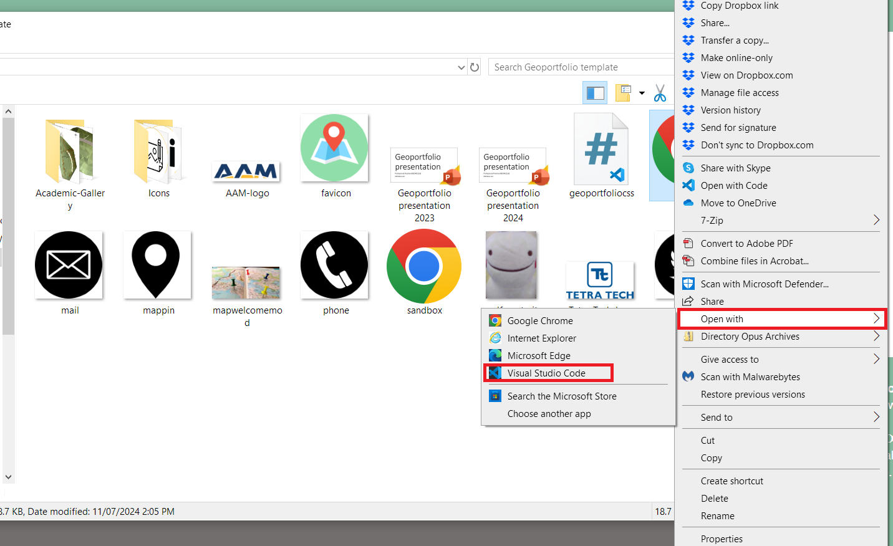

Slide 5
Important contents of my template
index.html – Main file that contains all the content and text of the Geoportfolio.
geoportfoliocss.css – CSS file of all the CSS used to style the Geoportfolio page.
sandbox.html – Duplicate of index.html used for testing and playing around without risking damage to the index.html template. Can also be used for comparing text to see if something could work or if something doesn’t work.
sandbox.css – Duplicate of geoportfoliocss.css. Same purpose as Sandbox.html as that is used for testing.
https://text-compare.com/ - Use this to compare between the two HTML files: The original index.html and your modified version

Slide 6
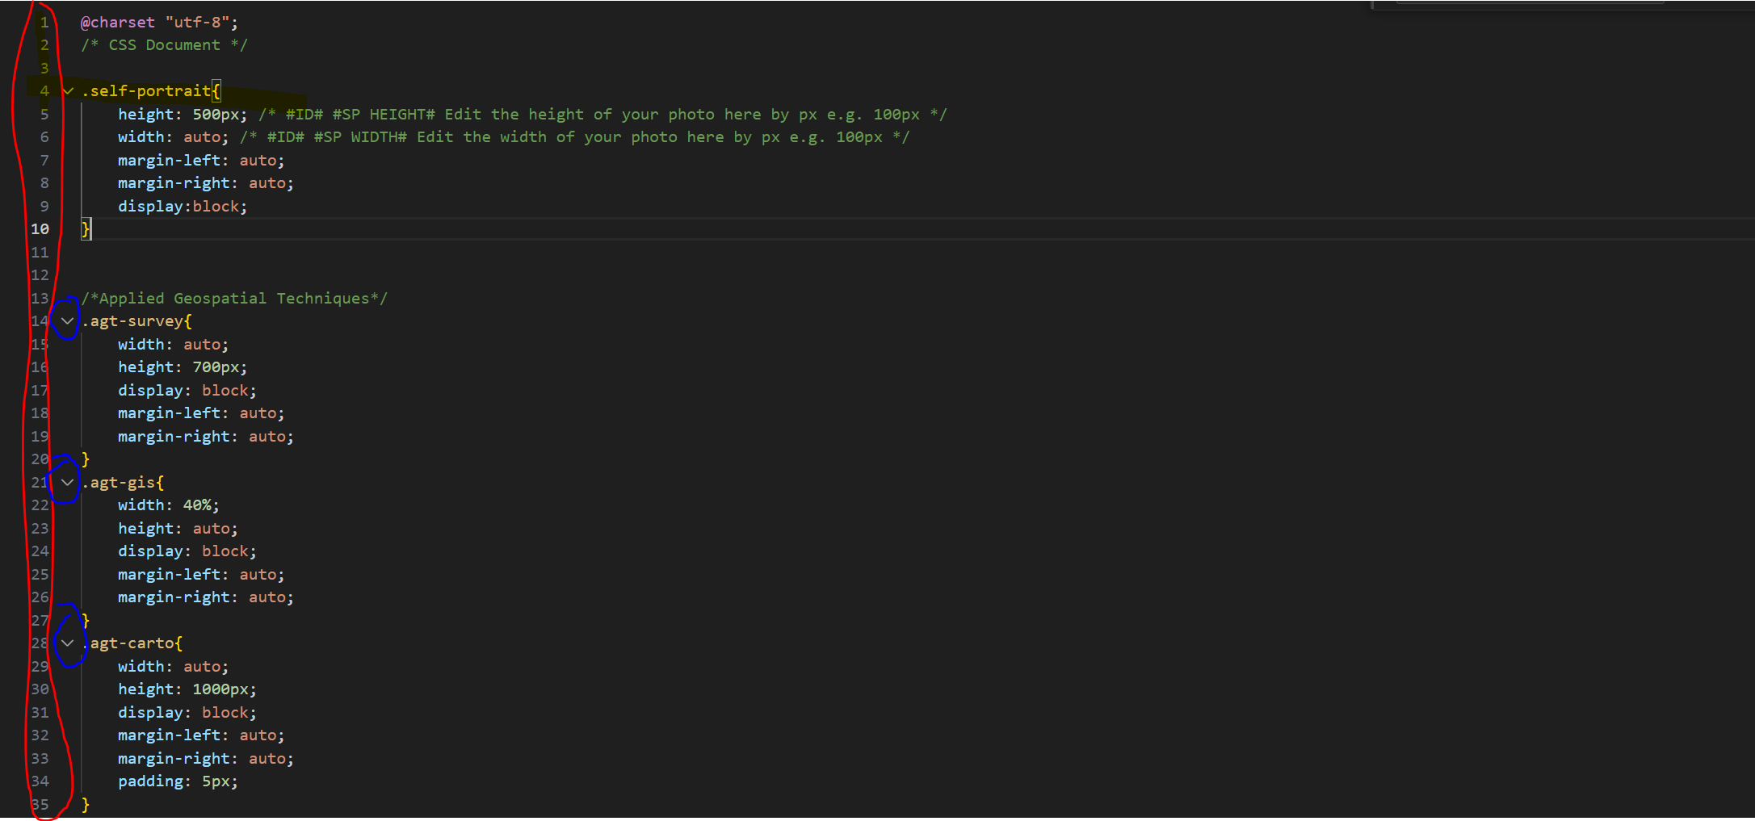
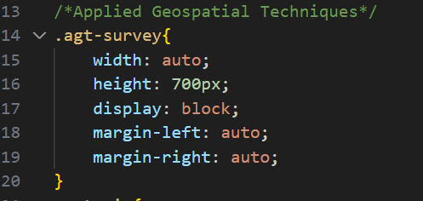
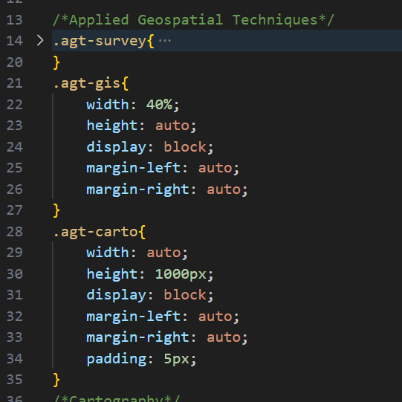
Hiding text – Click the arrow on the left of the code

Slide 7
What the code colours mean? (HTML)
Green text – Text that is a comment or note. It does not affect the code as they are notes for people viewing or using the code.
White Text – Text that will be displayed in the output.
Dark blue text – Represents an HTML element. Contains a start tag and end tag which is the same as the start tag except with a “/” in it e.g. <html> and /<html>
Orange text – Usually at the end of an = sign where it is inputted by the user e.g. a class or id defined.

Slide 8
What you need to personalise in the Geoportfolio template
Introduction and About
Academic Portfolio
Industry Experience
Skills and Proficiencies
Credits and Attribution
Contact and Compilation Information

Slide 9
Introduction and About
What needs to be changed:
The profile picture to be one of yourself (#SELFPORTRAIT#)
The text of the introduction to be modified about yourself (#INTROHEADING#)
Change the LinkedIn link to go to your LinkedIn profile (#LINKEDIN#)
Make sure that the name “Ditto Pikachu” is NOT present in your Geoportfolio. This Geoportfolio is about you, he is just providing the template he built.

Slide 10
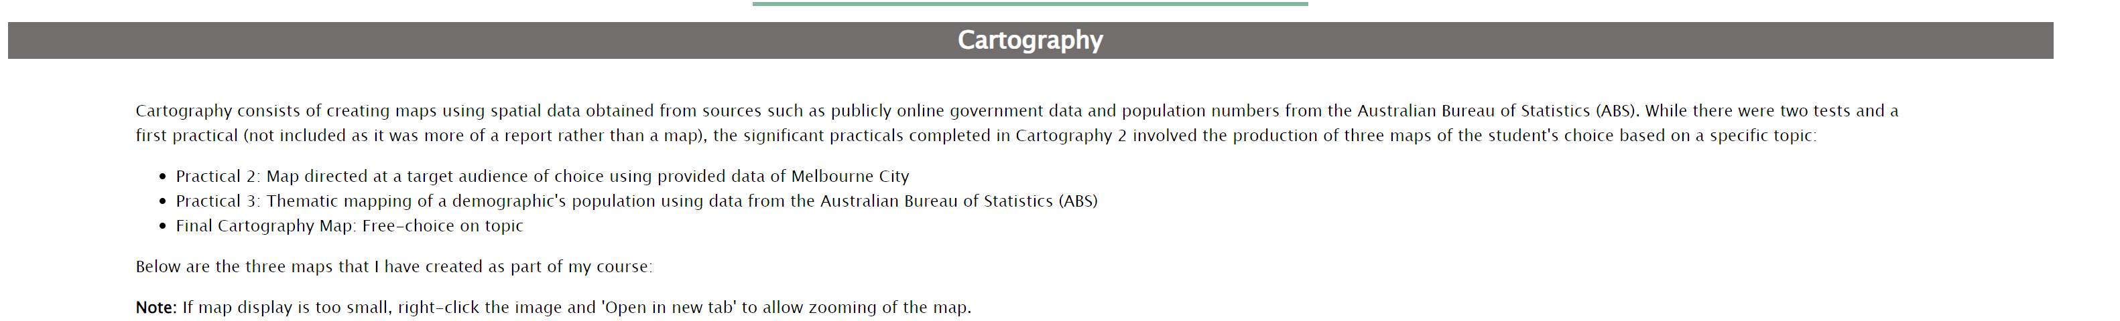
Academic Portfolio
What needs to be changed:
Change pictures to be of assignments YOU have done (#PICTURE#)
Change the heading and content of the text to be about subjects YOU have done (#SUBJECT#). You will need to rename the bar that says “Cartography” and change the text as seen in the image below

Slide 11
Image size editing
<img src="self-portrait.jpg" height="500px" width="auto" class="image">
img src: inside the quotations is the image file that will be displayed. If the image is in a folder named Icons, you will need to enter “Icons/self-portrait.jpg”.
Note: File extension is case sensitive. Image name must be EXACTLY HOW THE FILE NAME IS WRITTEN and must be in double quotations, including the file extension.
Height and width controls the proportions of the image. Having only one present will cause the other to be set to “auto” by default. These are some ways you can control image size:
-Auto: Auto indicates that if a height or width is entered but the other is auto, the image will automatically adjust proportionally.
-px: . Determines dimensions based on number of pixels. The example above sets the height to be 500px.
-Percentage (%): Controls dimensions of image based on the percent of its original size.
Class=“image”. A specially made class so that images are automatically displayed in the middle of the page. Do not touch this section.

Slide 12
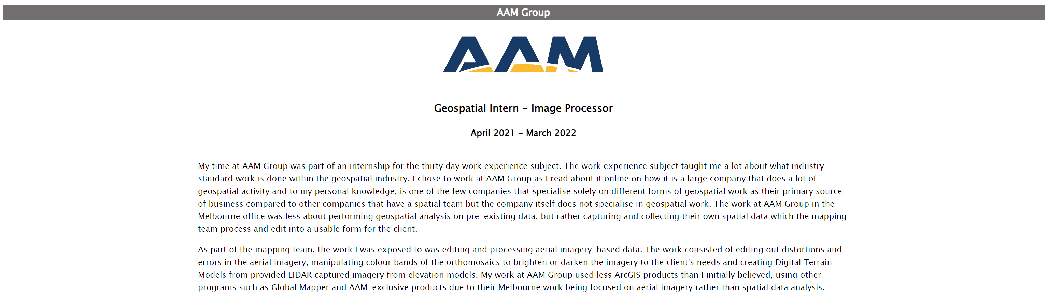
Industry Experience
What needs to be changed: (#COMPANY#)
Company logo to be of a place you have worked at.
Change the position name and time you worked there.
Change information of what tasks you have done, skills used, and hardware and software used in the industry.

Slide 13
Skills and Proficiencies, Credits and Attributions, Contact and Compilation Information
What needs to be changed: (#SKILLS#) – Icons and text to be of skills you know.
What needs to be changed in Credits and Attributions: (#CREDITS#)
Include attributions if icons are used from Flaticon.
Change the credits if applicable
What needs to be changed in Contact & Compilation Information (#FOOTER#)
Compilation Information (#COMPINFO#)
Contact information: Do NOT use any personal information! Use only your work credentials and contact information

Slide 14
Ctrl + F shortcuts for navigating my HTML template
To jump through all of them, they will all be marked #ID#.
#FAVICON# - To change the picture of the tab image
#NAME# - Change the name to YOUR name
#LINKEDIN# - Change the link to one of YOUR LinkedIn profile
#INTROHEADING# - Change intro heading bar text here
#SELFPORTRAIT# - Change to be your picture
#SUBJECT# - Change text to fit your subject and information.
#PICTURE# - Change to a picture of your assignment or company logo as outlined in the comment
#COMPANY# - Change the company information such as position and details
#SKILLS# - Change to the skills you have.
#CREDITS# - Change the credits and attribution based on your own personal use.
#COMPINFO# - Change compilation information based on your own personal use.
#CONTACT# - Change contact information

Slide 15
How to comment
HTML: <!-- This is a comment -->
For comments in the <head> and <body> code.
CSS: /* This is a comment */
For comments in your CSS file or in the <style> section.
JavaScript: //This is a comment
For comments in JavaScript files or in the <script> section.

Slide 16
Useful HTML notes
<p>Paragraph text</p> - Creates a new paragraph.
<br> - Breakline that puts the next text onto a new line. However, there is no spacing unlike a paragraph’s text.
<div class=“class” id=“id”></div> - Creates a container. Contents of the container is based on the text and images inside and the size and specifications is based on the CSS applied to the class and ID.
<img src="self-portrait.jpg" class=“image"> - Inserts an image of the file self-portrait.jpg with specifications of the class “image” on the CSS.

Slide 17
CSS – Cascade Styling Sheet
Allows you to modify all HTML classes and IDs at the same time on the separate file.
Helps keep HTML code tidy and allows for batch editing rather than needing to go to the separate divs to modify each section individually.
Code follows a different format than HTML.
Classes and IDs need to be contained in these brackets {}.
CSS functions usually go “function: specifications;”
CSS functions need to end in a semi-colon as seen in the sample text on the next slide.

Slide 18
Ctrl + F shortcuts for navigating my CSS template
To jump through all of them, they will all be marked #ID#.
#START DNT# - Start of the DO NOT TOUCH (DNT) part of my CSS. Mostly a formality but modifying the CSS in this section WILL affect the display of your Geoportfolio.
#END DNT# - End of the DO NOT TOUCH (DNT) part of my CSS.
#HEADER COLOR# - Change the colour of the header at the top of the page.
#FONT# - Changes the font of EVERYTHING.
#UL COLOR# - Changes color of underline in sub-titles of sections
#I WIDTH# - Changes the width of the icons in the “Skills and Proficiencies” table
#I HEIGHT# - Changes the height of the icons in the “Skills and Proficiencies” table
#BAR COLOR# - Changes the color of the bar
#BAR TEXT COLOR# - Changes the text color of the bar

Slide 19
Tips from personal experience
If certain code isn’t working, Inspect Element (Right click and press Inspect) can have the code be modified while the web page is open as seen in the next slide)
Alternatively, create a new HTML document and play around with just the code causing issues there. That can isolate the issue while not having to worry about other parts of your webpage.
Text compare can be used to compare between my original HTML code and your own to detect what is causing issues in code you think you left alone:
https://text-compare.com/

Slide 20
Tips from personal experience
When naming classes and IDs, create something unique and easy to remember. Naming it something basic (e.g. box) will make ALL contents with a class of box be affected. Naming it something too long (e.g. landscape images for only Applied Geospatial Techniques) will be a chore to type.
Comment, Comment, COMMENT! Leave comments on your code so you know what each code does. This will be helpful in case you need to make a change.

Slide 21
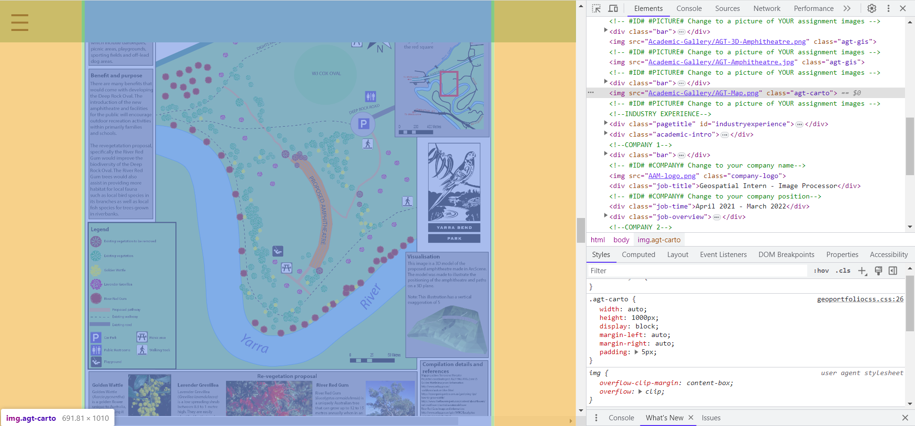
Inspect element is a useful tool for web design!

Slide 22
Important information
File extensions are case sensitive. If you write “work.PNG” but the image name is “work.png”, it will NOT be detected
Name your geoportfolio “index.html”. This is so that it will be detected as the main page when uploaded onto GitHub. The .html file extension must be in lowercase letters.

Slide 23
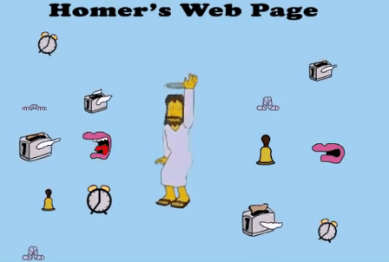
Rule of thumb: Widgets and effects are nice but only use them when necessary!
I do not want to see a page looking like this!

Slide 24




Good websites
Flaticon: Good for obtaining vector images for icons (Account and attribution required)
https://www.flaticon.com/
w3schools: Good for HTML and CSS tutorials
https://www.w3schools.com/
Stack Overflow: Good for searching for some issues (assuming a similar problem has been encountered and that there is a helpful response).
https://stackoverflow.com/

Slide 25

Sample Geoportfolios from previous students to help guide you
https://pupper42.github.io/ky_portfolio_web/#/
https://www.olivertrembearthsgeoportfolio.com/
https://oogumboogum.github.io/Geoportfolio_s3783650/

Slide 26

Publishing your webmap
This is done using GitHub where you need to make an account using your personal email.
Instructions are present on the assignment page.
WARNING: GitHub can be finicky so publish earlier than later.

Slide 27

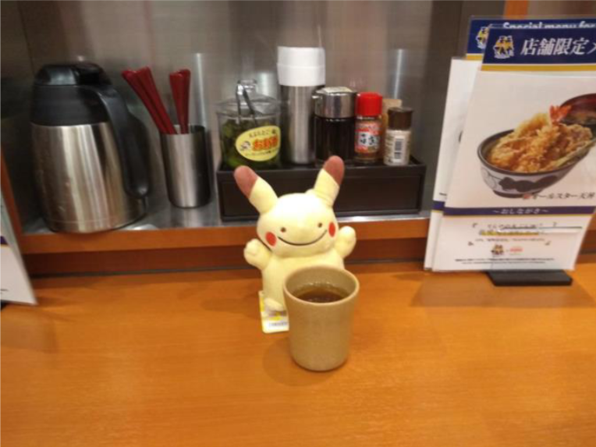
Well done for today!
Have a nice break or a cup of tea!
Message Nicholas Lee or any of the teaching team for further information or assistance with the Geoportfolio

Slide 28
Technical details
Further information on the technical aspects of the code and template

Slide 29
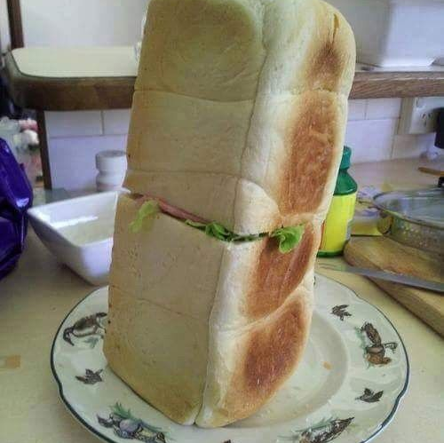
Designing the webpage is like making a sandwich
Sometimes the shop does it well, other times you can do it better!

Slide 30
Parts of the HTML sandwich
<html></html> - The “bread” of your sandwich: Everything has to be between the <html> and </html> tags. Without it, all the fillings will spread out.
<head></head> - The spread: All Metadata to go in here. Like butter/margarine spreads, you can modify it if you wish but can go without as the details that is not auto-generated is minor.
<style></style> - The secondary filling/salad: Any CSS/styling you want to apply to the items of the visuals is done here. Like salad, you can do this in a separate file just like how you can eat the salad on the side.
<body></body> - The primary filling: Everything that you want to be visually seen must be between these tags. Without the body, the sandwich will be two pieces of bread, some spread and condiments.
<script></script> - The condiments: The JavaScript programming to add animations or extra “flavour” to your page. Not needed but does add an extra kick to it.

Slide 31
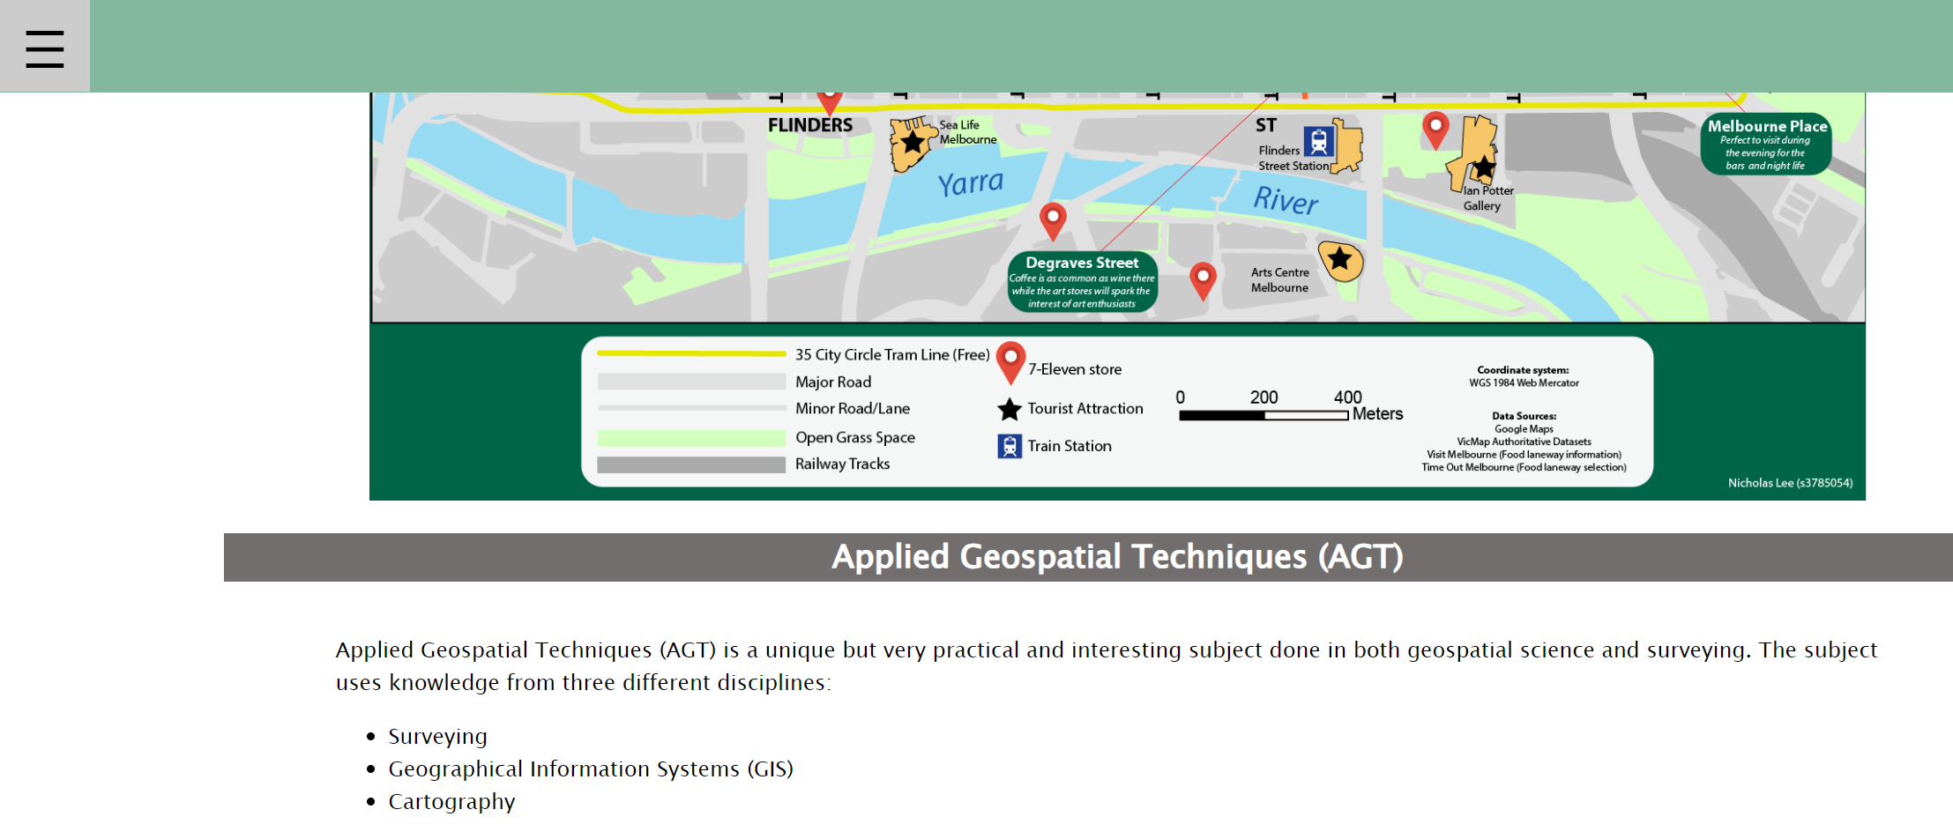
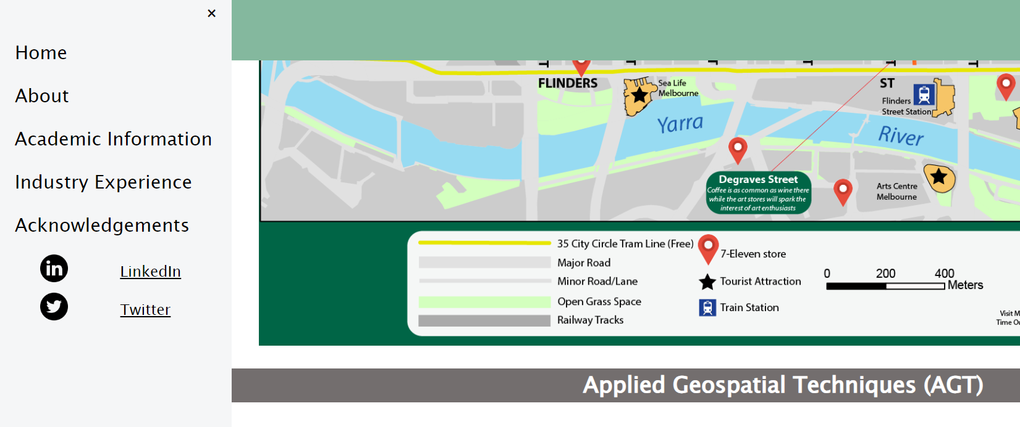
No <script>/JS applied
In this scenario, the buttons will not work as that is the only part of the page where JS has been applied.
Because the hamburger ☰ icon needs JS to be used to open the navigation menu, there is no navigation menu by default!

Slide 32


No <body>/content applied
No <body> tag = No content on the page

Slide 33
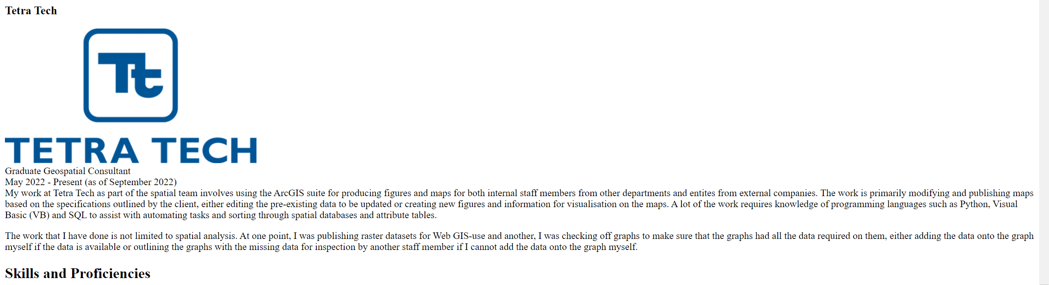
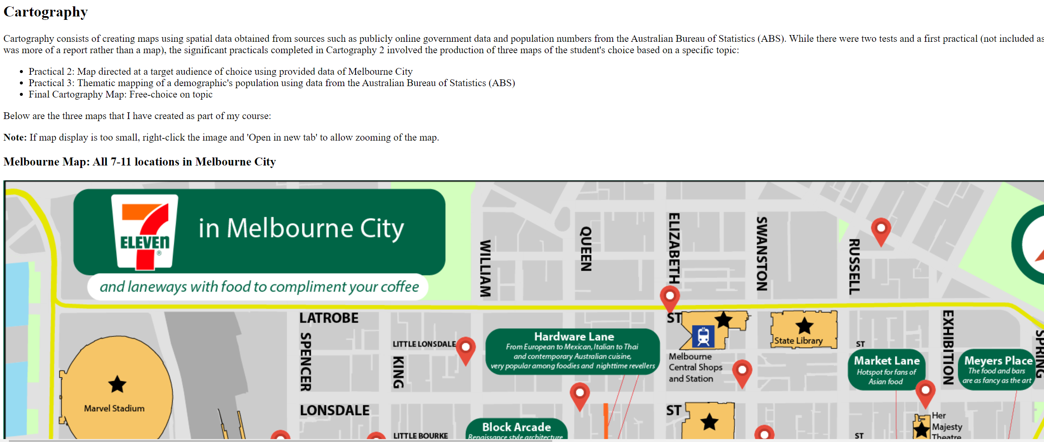
No <head>/CSS applied
Text defaults to Times New Roman and images are all over the place.
You can technically apply CSS in the HTML body but it will make the code very cluttered and messy.
That is why we use a CSS file!

Slide 34

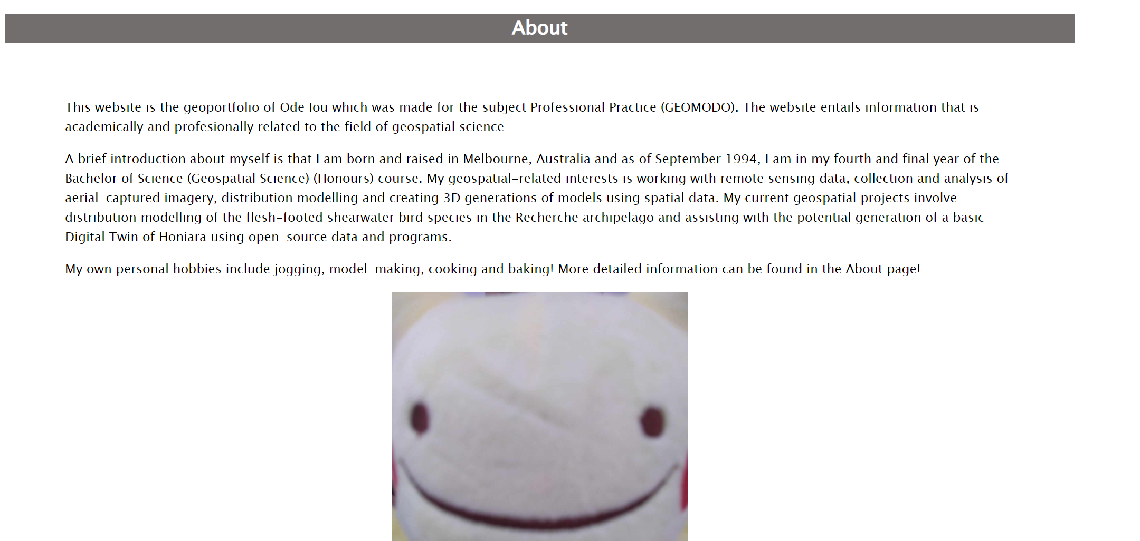
Full HTML and CSS applied

Slide 35
CSS sample text
.self-portrait{
height: 500px; - Creates a height of 500px
width: auto; - Width will be automatically applied based on the height. Image will still keep default proportions but is actual size is reliant on height.
margin-left: auto; - Left side of margin will be automatically calculated
margin-right: auto; - Right side of margin will be automatically calculated.
display:block; - Displays the element/object like its own paragraph and will take up the entire width of the page placement wise.
}

Slide 36
Useful CSS
Do NOT forget to end lines on CSS with a semi-colon (;) as seen in the sample code.
#id – ID for CSS but can only be applied to ONE object e.g. a div/box.
.class – Same as an ID but can be applied to MULTIPLE objects.
Z-index: Similar to the “Send backwards” and “Bring forward” with images on Word/PowerPoint. Positive numbers will bring objects forward/on top while negative numbers will bring objects lower e.g. z-index: -1;

